Slide 1







No diabetes
Pre-diabetes
Diabetes
Treatment 1
Variables
Treatment 3
Length of stay (LOS) in hospital significantly different between treatment strategies for each patient group, and between patient groups within treatment groups.
Relative risk of each of 9 separate acute events for people with pre-diabetes, compared to people with no diabetes (baseline)
Relative risk of each of 9 separate acute events for people with diabetes, compared to people with no diabetes (baseline)
Relative risk of any acute events for people with pre-diabetes, compared to people with no diabetes (baseline)
Relative risk of any acute events for people with diabetes, compared to people with no diabetes (baseline)
Treatment 5
For patient groups within a treatment strategy, using people with no diabetes as the baseline
For treatment strategies within a patient group, using Treatment 1 as the baseline

Slide 2
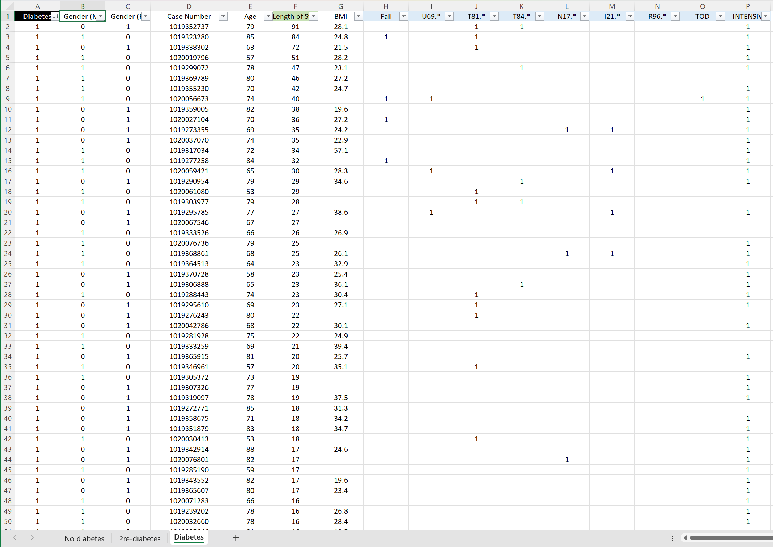
3 Excel spreadsheets
Each spreadsheet contains the data for one treatment strategy
Within each spreadsheet there are 3 workbooks, one for each patient group
Within each workbook the key variables are highlighted: Length of Stay (LOS) in green, Column F; Acute events in blue, Columns H-P.

Slide 3
Need to control for age
Adults ≥18 years | File 1 |  |  | File 3 |  |  | File 5
 | NOD | PRE-D | DIAB | NOD | PRE-D | DIAB | NOD | PRE-D | DIAB
Number of subjects | 1521 | 138 | 310 | 444 | 146 | 137 | 1222 | 174 | 228
Mean age (yrs) | 56.72 | 69.51 | 70.23 | 54.83 | 65.19 | 67.91 | 57.71 | 66.09 | 70.11
Mean length of stay (LOS) days | 10.07 | 11.73 | 12.20 | 10.27 | 9.21 | 9.47 | 10.27 | 10.22 | 11.82

Slide 4
No diabetes
Pre-diabetes
Diabetes
Treatment 1
Spreadsheet for Treatment 1
Treatment 3
Spreadsheet for Treatment 3
Treatment 5
Spreadsheet for Treatment 5

